Slide 1
👥 Team Members
Knaan Ahmad Saleh Hmedah - Backend (Firebase)
Motasem Hisham Shafeq Ramadan - Backend
(Firebase)
Faisal Jaber Abdelqader Naem - Frontend (html,css,js) Abdulrahman Abdullah Ramadan - AI (Gemini API)

Slide 2



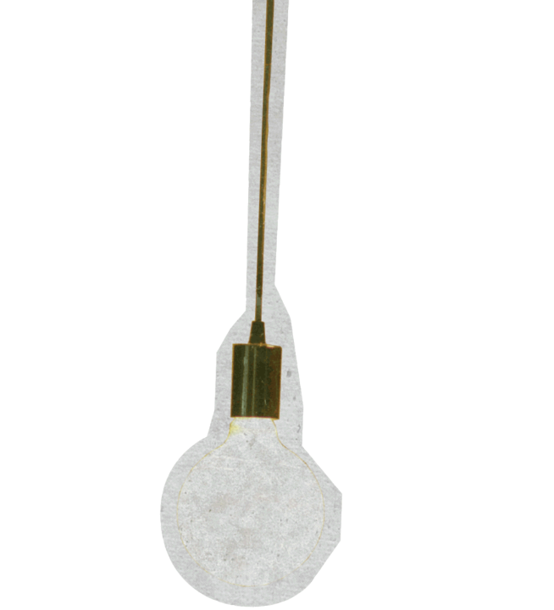












The Silent Problem
Imagine waking up every morning in a world where you can't hear a single sound
Imagine being unable to hear your favorite song, a child’s laughter, or even order a cup of coffee because no one understands you. For over 70 million deaf individuals worldwide, this is a daily reality—living in a world built for verbal communication, facing isolation and barriers to expressing themselves.
Other Apps Try to solve these problems, however they might be require the user to
,be tech literatue which can be a barrier to entry
Our App tries to solve this problem, by being easy to use, however powerful enough to translate different Sign Languages into Text

Slide 3





Our Solution: HAND TALK
Inspired by sgin.mt (text & audio → motion).
Added Sign Language Dictionary (Jordanian, American, British & general).
Image upload & translation with Gemini AI. Voice search for movement meanings in any language.
Arabic & English support.
Dark & light modes for eye comfort.

Slide 4
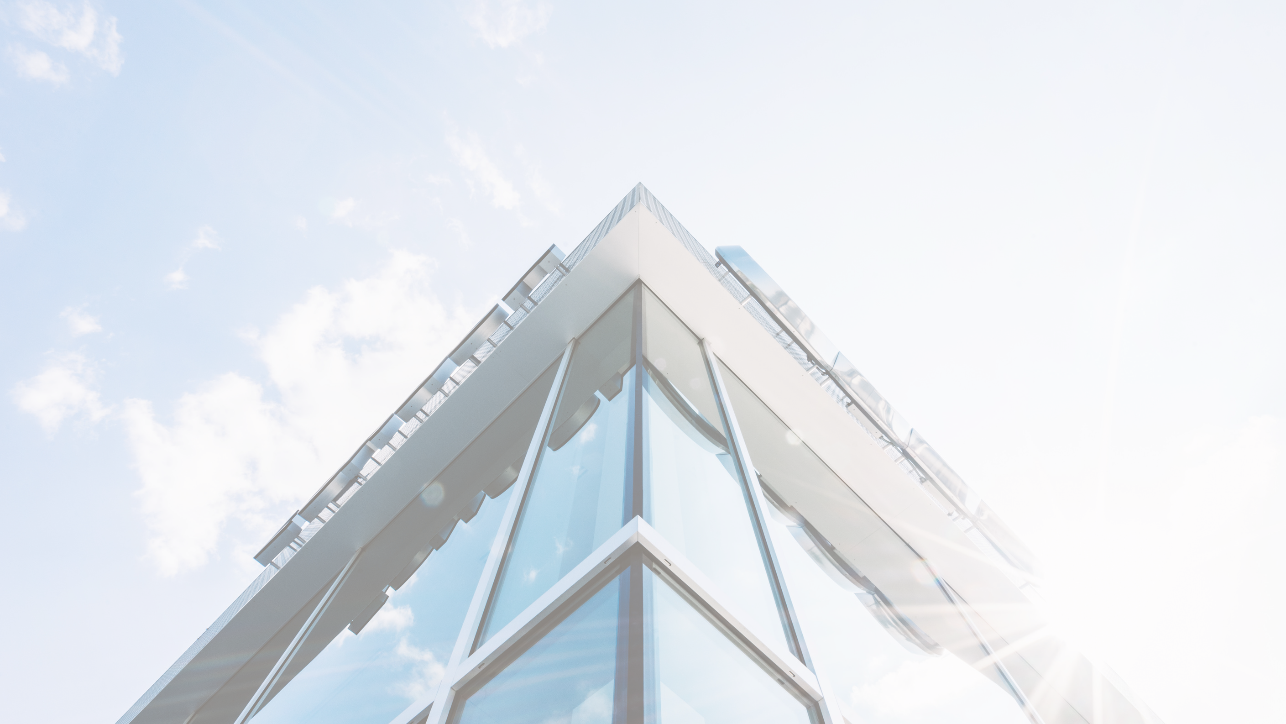
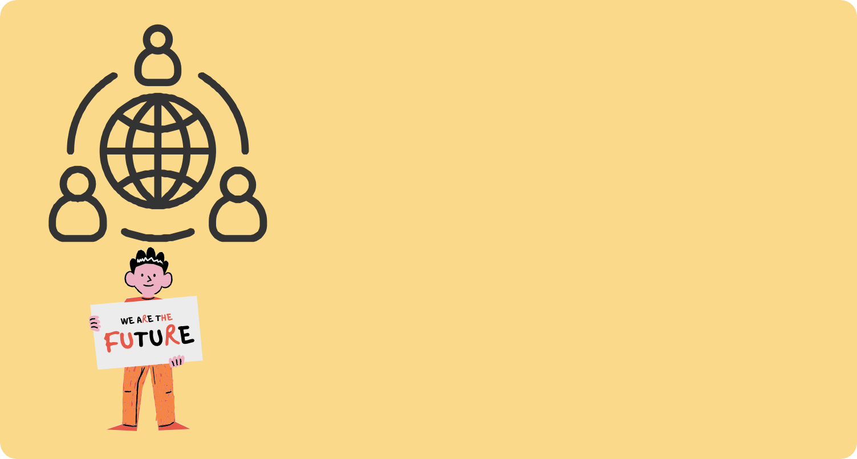

Impact
,Social: Facilitating access to education
.healthcare, and everyday services Commercial (optional): Potential integration
.with banks, hospitals, or retail stores Future Vision: Supporting multiple sign languages + developing a mobile
.application

Slide 5

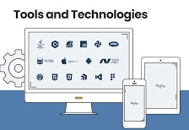
Tools s&Technologies in the Project
Frontend
Html ,css,js بناء واجهة المستخدم :
Webcam Integration →التقاط الاشارة من الكميرة
. Real-time Text Display → المباشرة ﺔﻴﺼﻨﻟاﺔﻤﺟﺮﺘﻟا. Animated Signs / GIFs →لإظهار إشارات لغة الإشارة من النصوص
.
Backend (Firebase)
Firebase Authentication → /لﻮﺧﺪﻟا ﻞﻴﺠﺴﺗ.
Firebase Functions → ربط الذكاء الاصطناعي مع الواجهة الامامية
AI (Gemini API + Google Colab)
Gemini
googel search api key :بأستخدام قوقل ﺚﺤﺒﻟا

Slide 6
